Slide 1
MAR THOMA CHURCH Diocese of North America & Europe
DIOCESAN ACTIVITIES
PRESENTATION

Slide 2
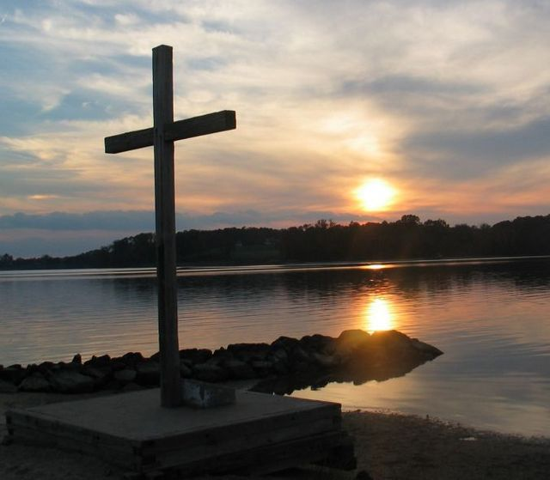
The Church is the
real presence of Christ.
~Dietrich Bonhoeffer, Cost of Discipleship

Slide 3
Context: Diocesan Assembly & Diocesan Council
Diocesan Administration
Each Diocese of the Mar Thoma Church is led by a Diocesan Bishop
The Diocesan Bishop supervises the local administration of the Diocese, subject to the approval of the Metropolitan
The Bishop is assisted in administration of the Diocese by the Diocesan Assembly and the Diocesan Council
Diocesan Assembly
Diocesan Council
Representation
All parishes in the Diocese are represented in the Assembly
All Achens in the Diocese, including retired Achens, are members
Led by the Diocesan Bishop
Elected members include
Secretary
Treasurer
Council Members
Responsibilities
Passes the annual report, accounts, and budget of the Diocese
Takes appropriate decisions for the development of the Diocese
Elects the Diocesan Council
Implements the decisions of the Assembly
Assists in advising the Diocesan Bishop

Slide 4
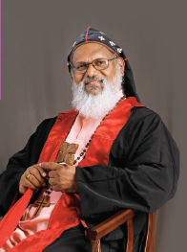
Diocesan Bishop
Rt. Rev. Dr. Geevarghese Mar Theodosius
Episcopa

Slide 5
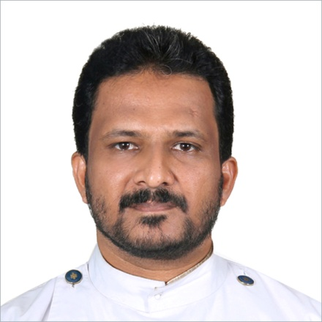
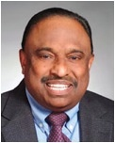
Diocesan Secretary
Rev. Binoy J. Thomas
Diocesan Treasurer
Mr. Philip Thomas

Slide 6
Diocesan Programme Manager
Rev. Dr. Philip Varghese
Diocesan Office Assistant
Mr. Thomas Oommen (Saji)

Slide 7
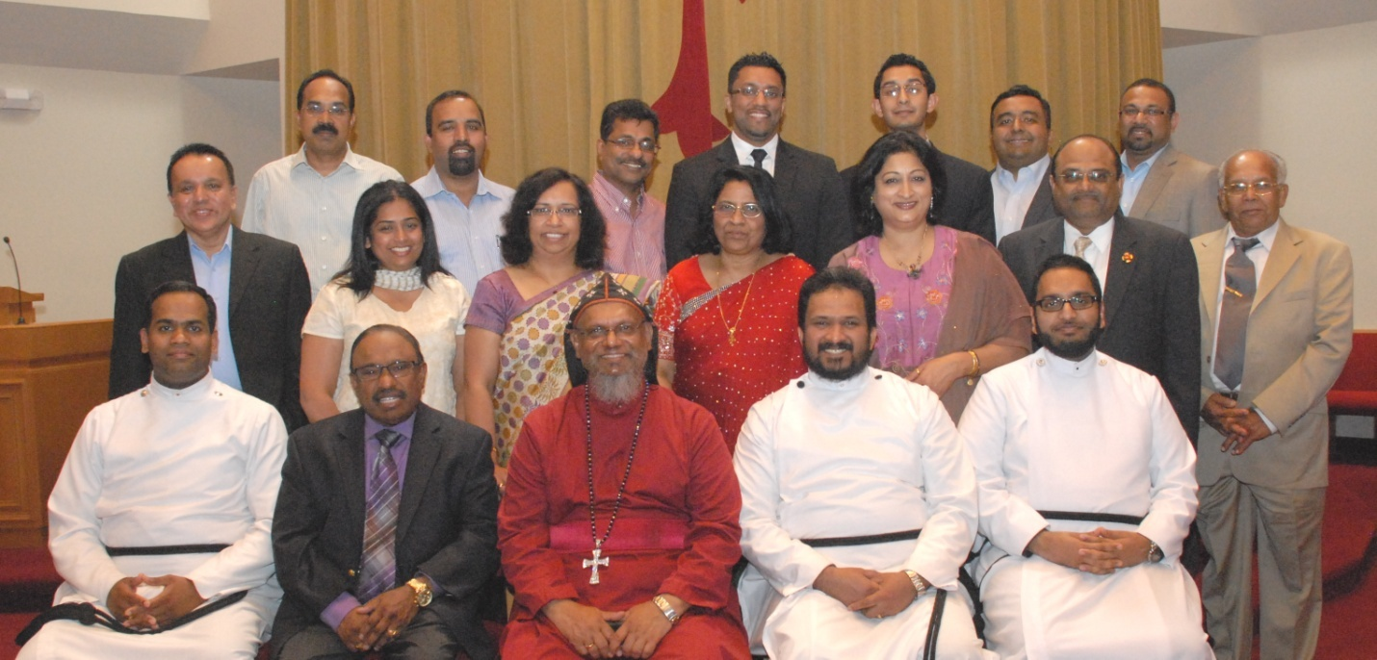
Diocesan Council Members
Rev. Biju P. Simon
Rev. Dennis Abraham
Dr. Mathew T. Thomas
Mr. Baby M. Samuel
Mr. George Mathai
Mr. Samuel K. Samuel
Mr. Jaffey Chacko
Mr. Zachariah Koshy
Mrs. Kusumam Titus
Mrs. Mariamma Abraham
Mrs. Susan Koshy
Ms. Sini Jacob
Dr. Ron Jacob
Mr. Jason Varghese
Mr. Jorge V. Wilson
Mr. Zachariah Mathew

Slide 8
Diocesan Subcommittees
Mar Thoma Messenger
Diocesan Website
Mission Board
Ecumenical Relations
Lay Institute (LEAD Program)
Literature Society
Suvishesha Nidhi
Senior Fellowship
Archives Committee
Planning Board
Media and Public Relations
Legal Affairs Committee
Vaideeka Selection
Publication Board
Mar Thoma Merit Award

Slide 9
PLANNING BOARD
The plans of the diligent
lead surely to abundance, but everyone who is hasty comes only to poverty.
–Proverbs 21:5

Slide 10
Planning Board Constituted in June 2008
Objective:
To develop short-term and long term plans that would further strengthen the faith, mission, activities, and growth of the Diocese.

Slide 11
Subcommittee
Rev. Binoy J. Thomas, Diocesan Secretary
Mr. Philip Thomas, Diocesan Treasurer
Ms. Sini Jacob, Convener
Members:
Mr. Jorge Wilson
Rev. Dennis Abraham
Dr. Ron Jacob
Dr. Mathew T Thomas
Mr. Chacko Mathew

Slide 12
Short Term Plans
Improve communication within the Church
Diocesan resource mapping initiative
Engaging youth and adults in the Church activities
Long Term Plans
Engaging in the Federal Faith-based initiatives program
Studying the feasibility of a Seniors Residence Center

Slide 13
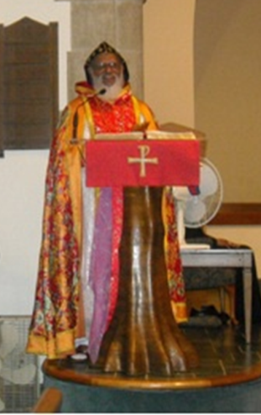
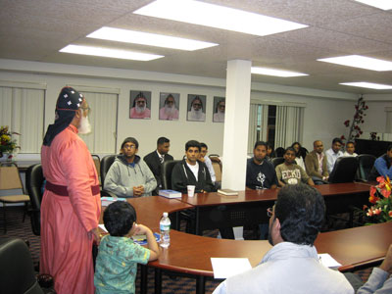
Accomplishments
Initiated Bishop’s Messages on Diocesan Website
Resource Mapping Initiative to identify available human resources to better plan future activities
Coordinated dialogue sessions between youth
and young families

Slide 14
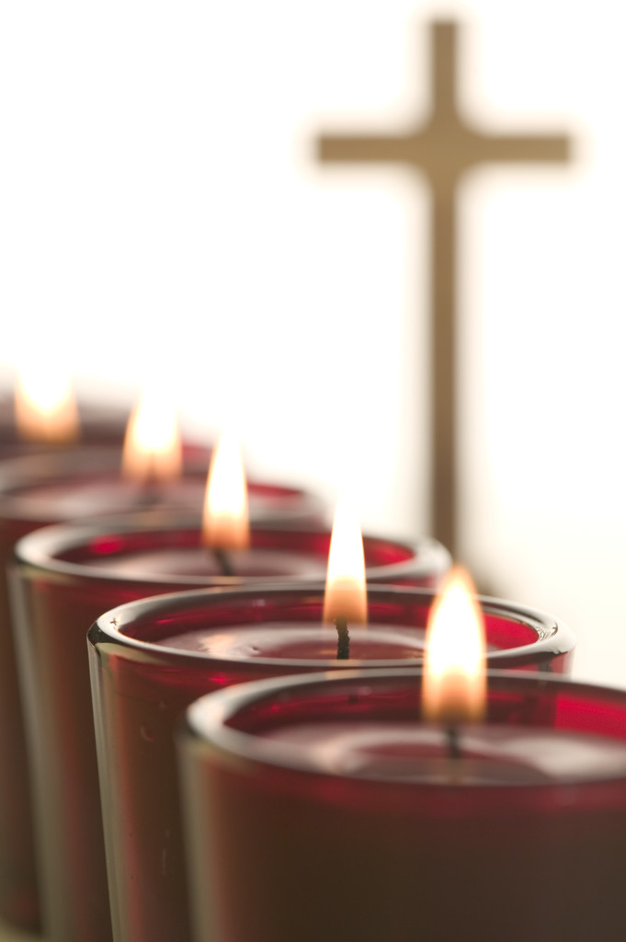
Lay Institute
L.E.A.D Program
Layperson Education And Development
This program provides all members of the Mar Thoma Church an opportunity for continuing education in order to develop and edify leaders to serve the church community.

Slide 15
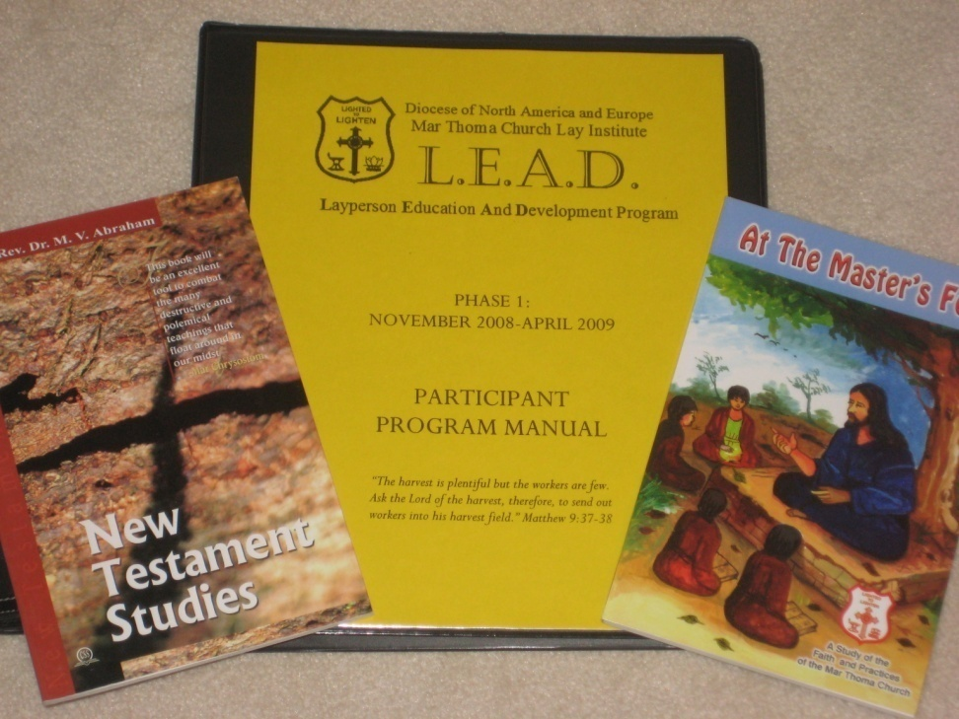
The L.E.A.D. Program assists in:
the Spiritual Growth of Individuals
the Spread of the Gospel through the Leaders from the L.E.A.D Program

Slide 16
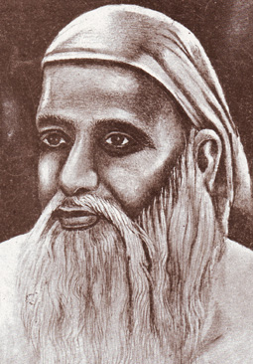
Phase I Courses
Liturgy
Worship
Introduction to Old Testament
Introduction to New Testament
History of Christianity/Mar Thoma Church
Mar Thoma Church Doctrines and Sacraments

Slide 17
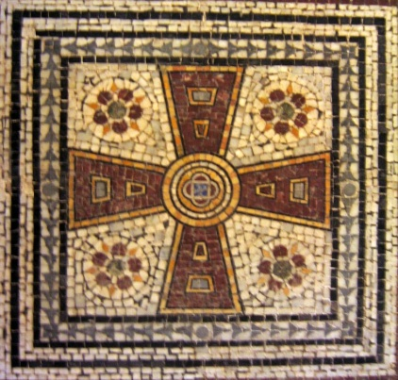
Phase II Courses
Missions
Prophetic Literature
Pauline Epistles
Polity of the Mar Thoma Church
Understanding our Neighbors
Introduction to Christian Theology

Slide 18
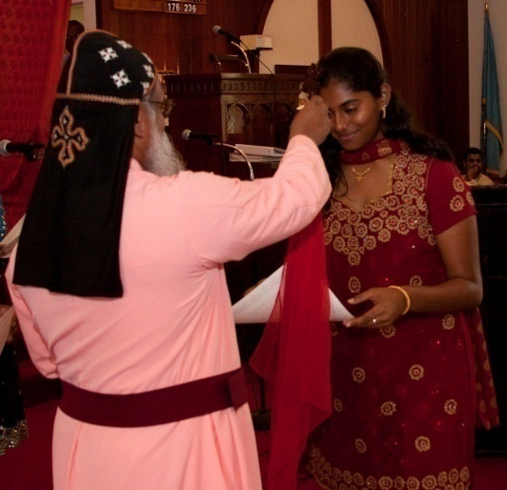
LEAD PROGRAM
Subcommittee
Rev. Binoy Thomas, Diocesan Secretary
Mr. Philip Thomas, Diocesan Treasurer
Mr. Jason A. Varghese, Convener
Members:
Rev. Larry Philip Varghese
Mrs. Susan Koshy
Ms. Betty Vattakunnel
Mr. Mathews Athiyal
Regional Conveners:
Rev. Shibu Mathew
Rev. M.E. Shaji
Rev. Binu Thomas
Rev. Daniel Thomas
Rev. Mathew John
Rev. Biju K. George
Rev. Dr. Thomas Philips

Slide 19
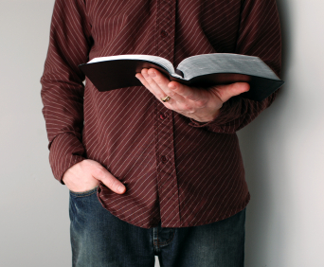
Lay Youth Chaplaincy
Implement a
pilot program
for Lay Youth
Chaplaincy
Applications are welcomed.

Slide 20
For more information
about the LEAD Program:
Contact
Mr. Jason Varghese, Convener
MTC.LEADprogram@gmail.com
Jason.A.Varghese@gmail.com
(551)-265-2706

Slide 21
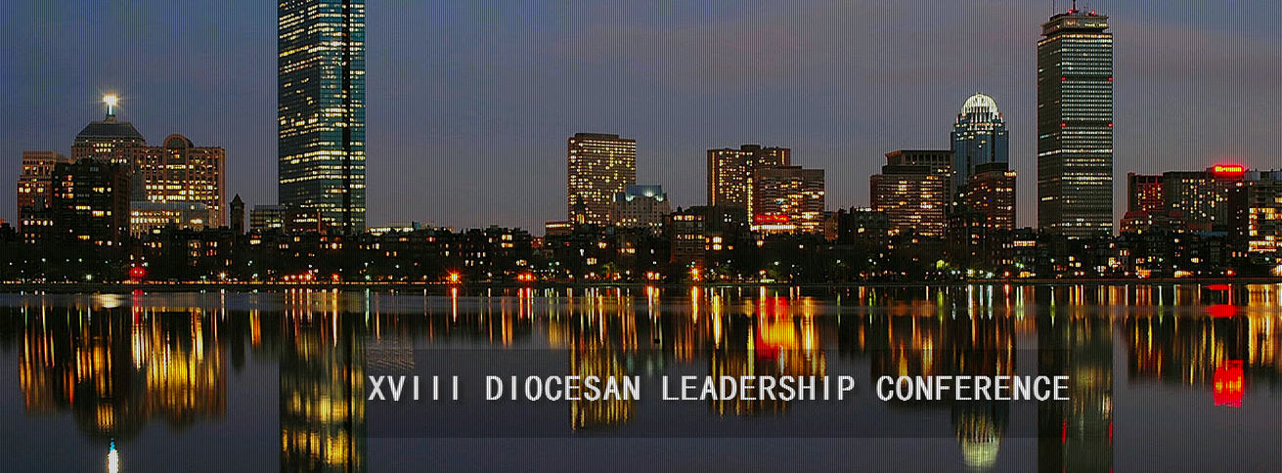
Leadership Conference
Equip future leaders with a toolkit needed to serve their individual churches and the Diocese
Challenge each leader with workshops and training sessions

Slide 22
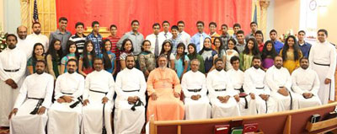
Altar Boys and Covenant Girls
Train in the faith and practices of the Church
Requirement: Boys and girls above the age of 12 and who are communicant members of the Church
Subcommittee:
Rev. Dennis Abraham – Convener
Regional Clergy Conveners

Slide 23
MISSION BOARD
Proclaiming the Gospel to all the nations
missionboard@marthomamission.com

Slide 24
Mission Board Ministries
Mexico Mission
Native American Mission
India Mission
Neighborhood Missions:
Campus Ministry
Prison Ministry
Medical Mission

Slide 25
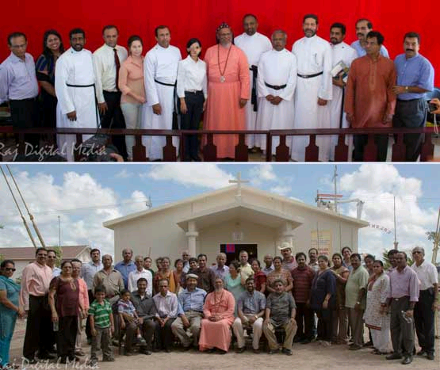
Mexico Mission mexico@marthomamission.com
Development of the basic infrastructure of Colonia Mar Thoma to include water, electricity, kitchen, bathrooms, etc.
Select and appoint a fulltime resident missionary.

Slide 26
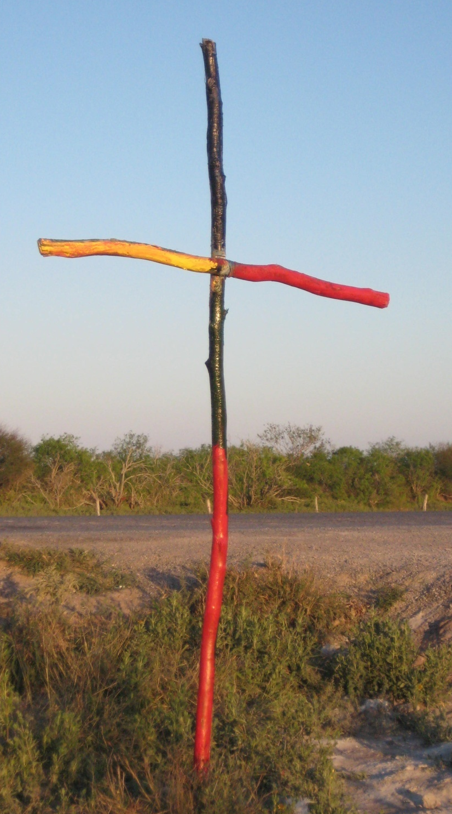
Subcommittee
Ms. Sini Jacob, Convener
Members:
Rev. Saju Mathew
Rev. Kochu Koshy Abraham
Rev. Roy A. Thomas
Mr. Sabu T. Cherian
Ms. Arlene Mathew
Mr. Abraham C. Thomas
Mr. John Thomas

Slide 27
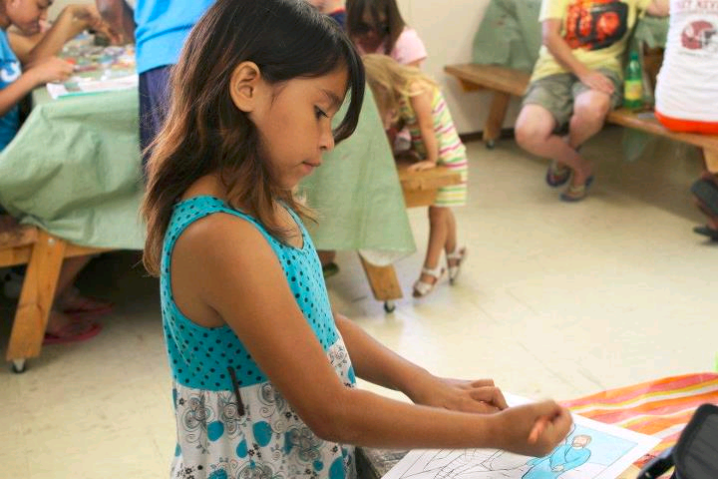
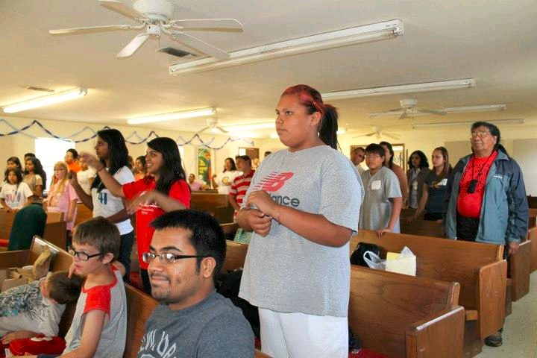
Native American Mission
Organizes mission activities among the Choctaw and Houma Native American communities in Alabama, Oklahoma, and Louisiana. Conducting regular V.B.S. mission trips in Alabama and Oklahoma. Assisting the disaster relief efforts in the reconstruction of homes in Dulac, Louisiana.

Slide 28
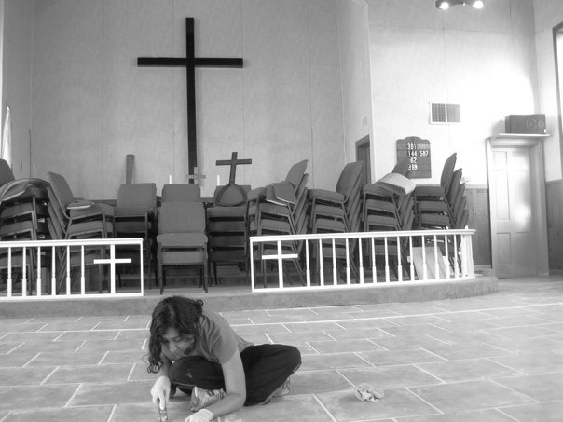
Subcommittee
Rev. Dennis Abraham, Convener
Members:
Mr. Joseph Koshy
Mrs. Nirmala Abraham
Ms. Nithu Thampy
Rev Shibi Abraham
Rev. Jose C. Joseph Mathew

Slide 29
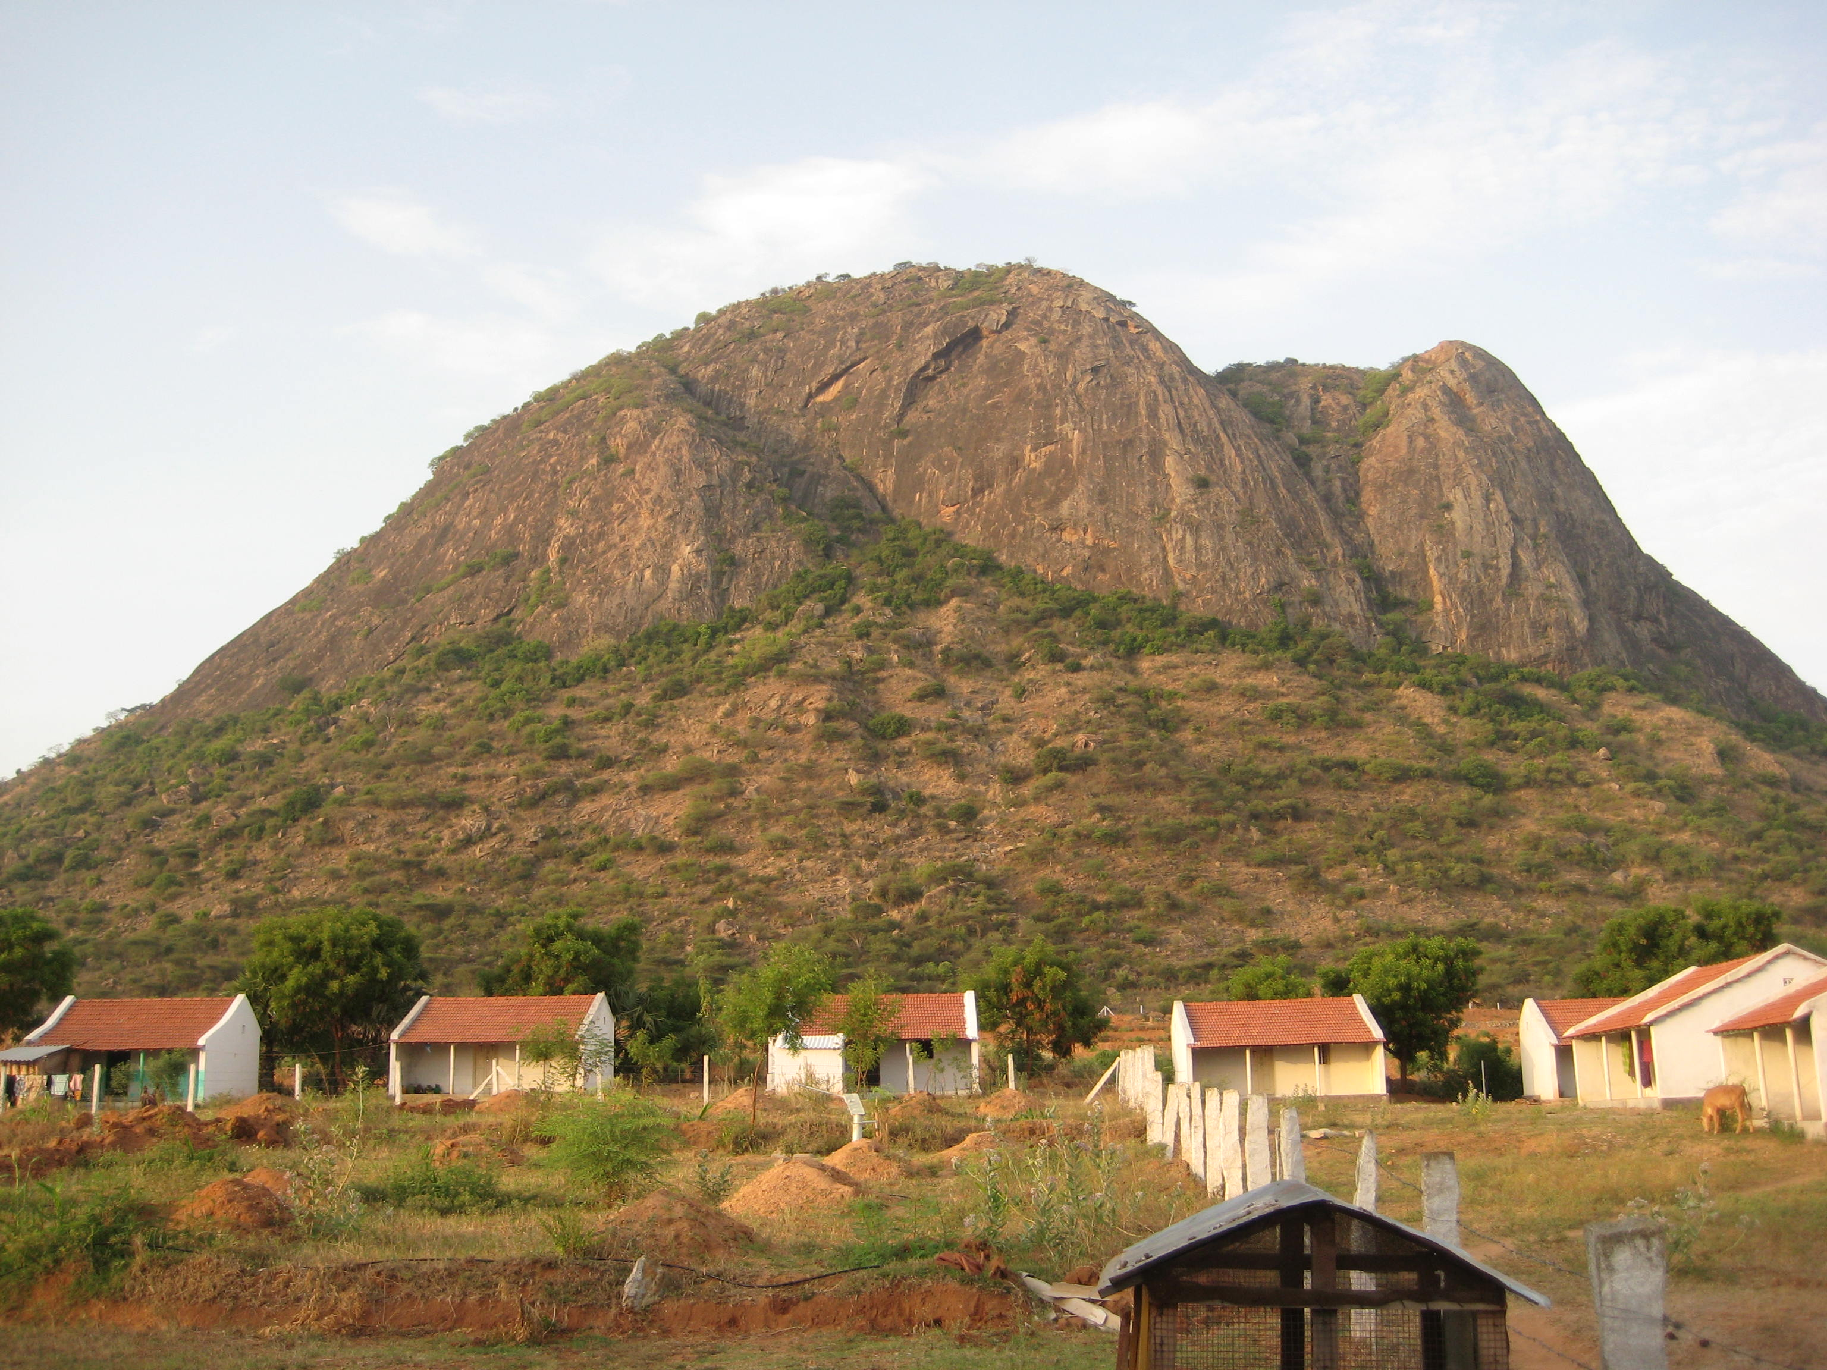
Mission in India
Organizes an annual mission trip to different mission fields of the Mar Thoma Church in India and encourages participation from members of the Diocese, especially the youth.
Developing the Ittarsi Mission field in the Delhi Diocese, conducting mission programs in Sihora, Bopal, etc…
Subcommittee
Mrs. Mariamma Abraham, Convener
Members:
Mr. George Mathai

Slide 30
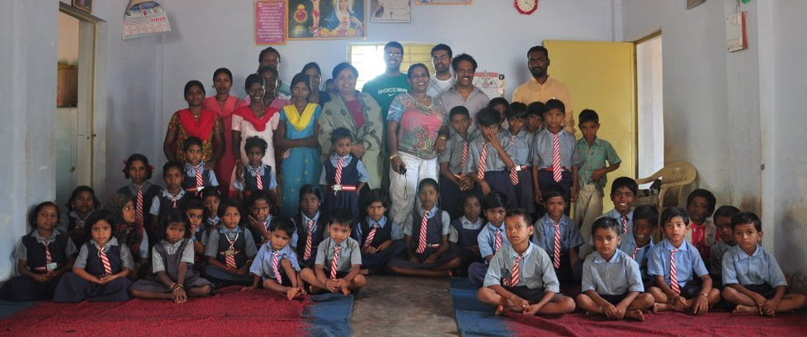
Next India Mission Trip
Tentative Dates: end of July 2015
Navajeevan Centre and
other Mission Centers in Bombay, India
Please express your interest to
If interested, please contact
Mrs. Mariamma Abraham (India Mission Convener)

Slide 31
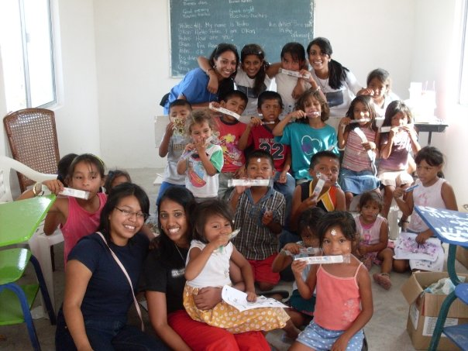
Neighborhood Mission
Rev. Biju P. Simon , Convener
Members:
Ms. Pushpa Samuel
Dr. Ron Jacob
Mr. Mathew Thomas
Mrs. Sherry Mathew
Mr. Benny Philip
Mr. Shibu P. John
Mr. Shani Abraham
Mr. Alex Mathew
Mrs. Annie George
Mr. Prakash Abraham
Mr. Sean George

Slide 32
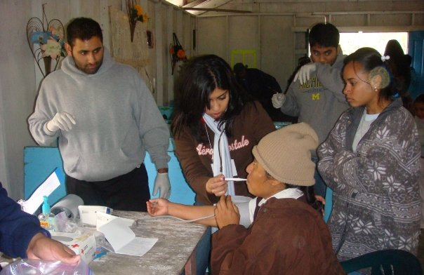
Neighborhood Missions: Medical Mission
Addresses the medical needs in the mission
fields of the Mar Thoma Church while
proclaiming the Gospel

Slide 33
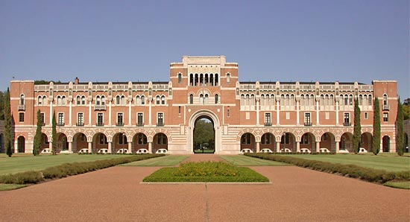
Neighborhood Missions: Campus Ministry campus@marthomamission.com
Focuses its efforts to keep students engaged in their faith during their college career and to provide training to high school students preparing to enter college

Slide 34
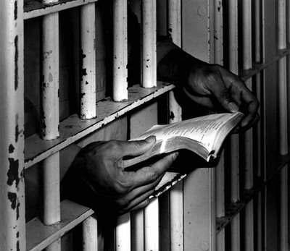
Neighborhood Missions: Prison Ministry
Develops ways that our Diocese can support and assist those in prison and their families develop a personal relationship with Jesus Christ.

Slide 35
Suvishesha Nidhi (Mission Fund)
Sunday, August 3, 2014
The collection of the Diocese for mission work. Donate $1/month for a total of $12/year per earning member
Mrs. Susan Koshy, Convener
Rev. Christopher Phil Daniel
Dr. John K. Thomas

Slide 36
Going Green Initiative
Diocesan Project in honor of Rt. Rev. Dr. Geevarghese Mar Theodosius’ Episcopal Silver Jubilee
Mr. Baby M. Samuel, Convener
Ms. Shaina Varghese
Mrs. Kusumam Titus
Mr. Renoy Kurien
Mr. Thomas Abraham

Slide 37
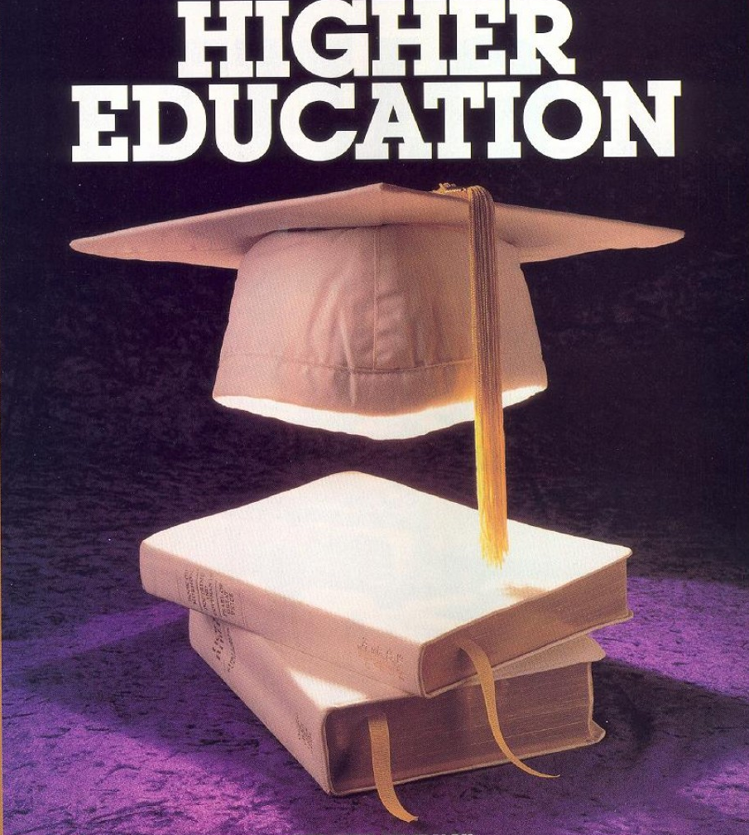
Clergy Higher Studies
Rev. Dennis Abraham, Convener
Dr. Mathew T. Thomas
Mrs. Mariamma Abraham

Slide 38
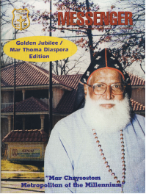
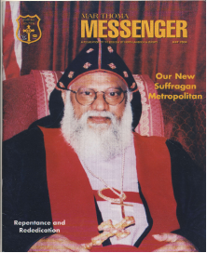
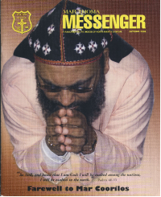
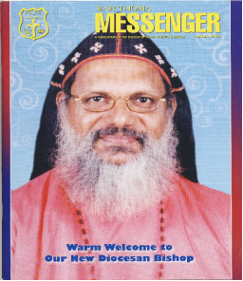
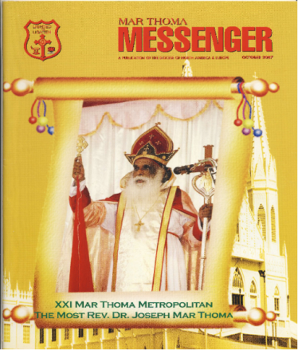
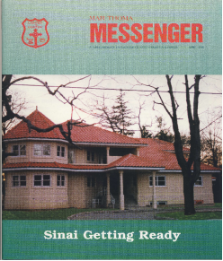
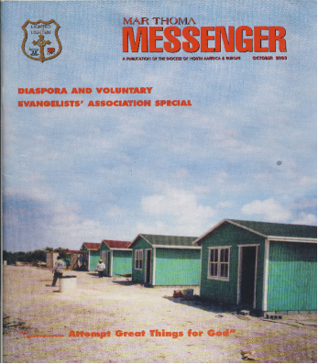
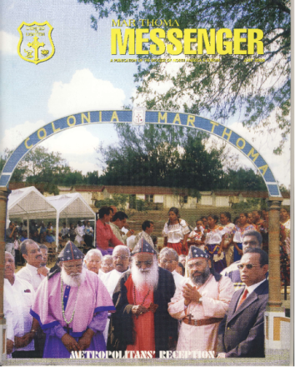
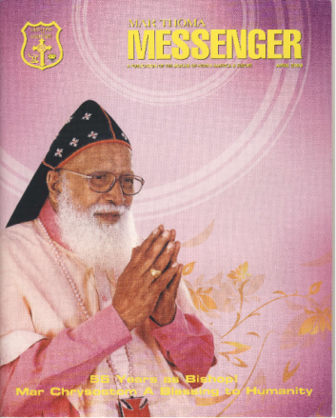
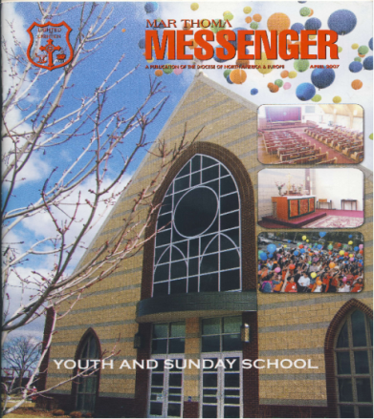
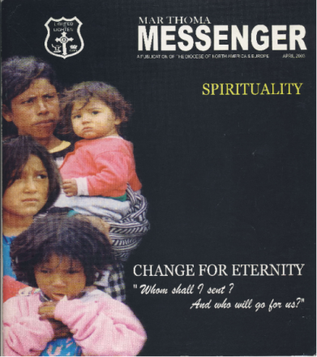
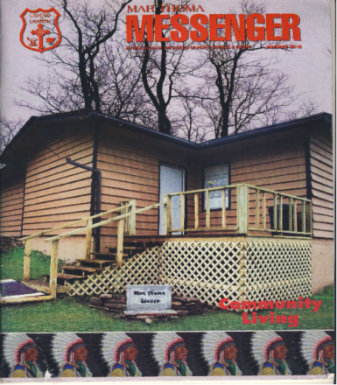
Mar Thoma
Messenger
CELEBRATING ITS 32nd YEAR OF PUBLICATION

Slide 39
MESSENGER THROUGH YEARS

Slide 40
Mar Thoma Messenger
Current Subscribers: 3,000
Number of Issues Per Year: Four (4) - A Quarterly Publication
Articles, Youth Corner, Kid’s Corner With Photos
Diocesan Bishop’s Message, Metropolitan’s Message, Bible Study, and Editorial
News from Parish and Organizations With Photos
SUBSCRIPTION RATES
Two Years-$25 (Canada $25, UK £12)
Five Years-$60 (Canada $60, UK £30)
Life Membership - $300/UK £180

Slide 41
PLEASE SUBSCRIBE TO MESSENGER
PLEASE SUBSCRIBE TO
MAR THOMA MESSENGER!

Slide 42
EDITORIAL BOARD
Rt. Rev. Dr. Geevarghese Mar Theodosius – Patron, Diocesan Episcopa
Rev. Binoy J .Thomas, Diocesan Secretary
Dr. Mathew T.Thomas, Chief Editor
Associate Editors:
Mr. Santhosh Abraham
Mr. George Sam
Dr. Nancy George Maliacal
Ms. Laila Alex
Ms. Mary Varghese

Slide 43
MANAGING
COMMITTEE
Rev. Binoy J. Thomas, Convener
Mr. Philip Thomas, Diocesan Treasurer
Members:
Mr. Samuel K. Samuel
Mr. Jaffey Chacko
Mr. Zachariah Mathew
Mr. T.A. Mathew
Mr. Georgey Mathews

Slide 44
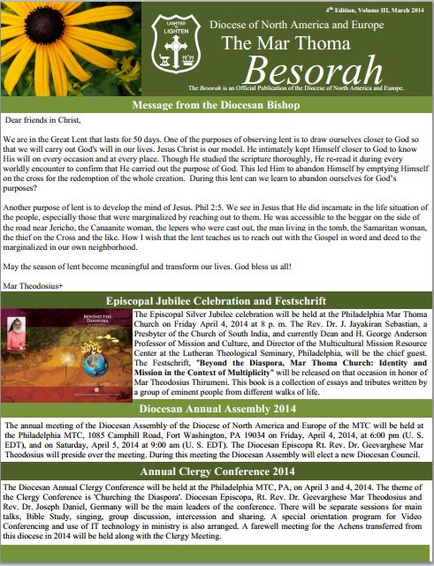
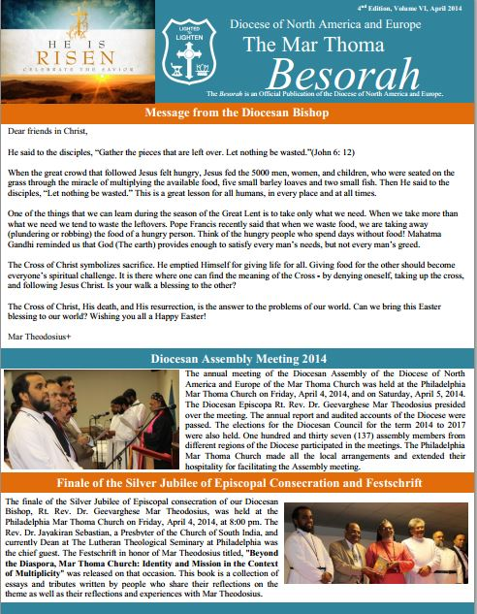
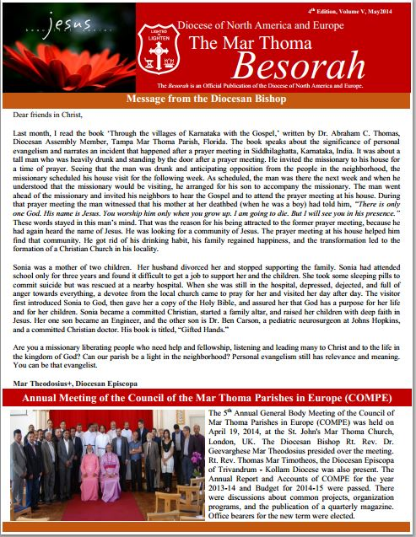
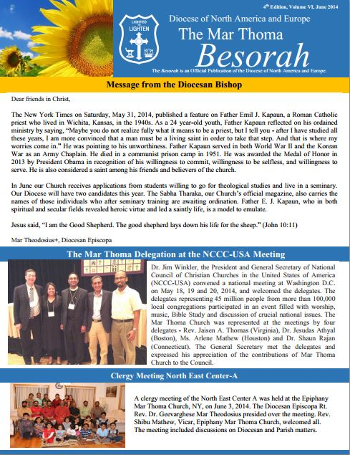
Mar Thoma Besorah
Official Publication of the Diocese
Rev. Binoy J .Thomas, Diocesan Secretary
Dr. Mathew T. Thomas
Ms. Betty Vattakunnel

Slide 45
LITERATURE SOCIETY
Established in 1991 by:
Most Rev. Dr. Philipose Mar Chrysostom
Valiya Metropolitan
at the Family Conference, Florida

Slide 46
PUBLICATION BOARD
The Publication Board aims at publishing books, study materials, and organizing for the Diocese. In effectuating this, study materials on the various conference themes throughout the Diocese are organized on a thematic basis.

Slide 47
Literature Society: Activities
Distribution of Sunday School materials
Distribution and sale of Sabha Publications
Sale of Bibles, Hymn Books, Worship Books, CDs, Audio Cassettes, Videos, etc…
Distribution and sale of Christian literature
Sale of Novelty items
Distribution and sale of Diocesan publications

Slide 48
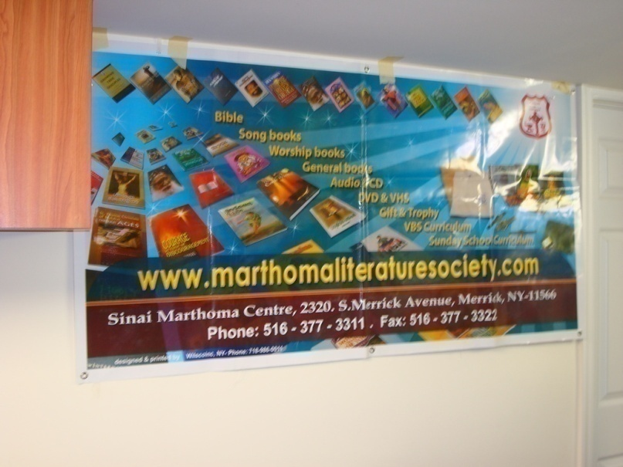
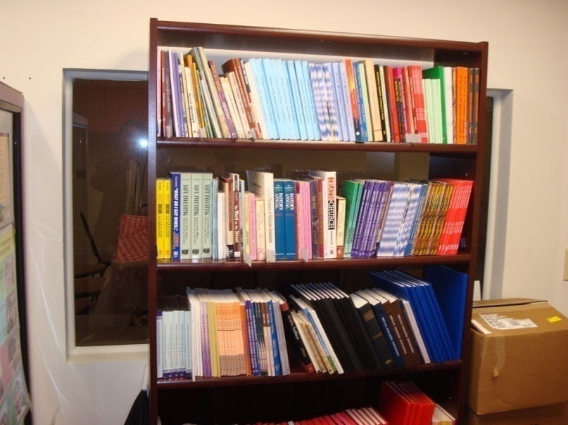
Literature Society: Goals
Have a store front of our own
Establish libraries in churches
Develop as a base for all printing and publications

Slide 49
SUBCOMMITTEE
Mr. Philip Thomas, Convener
Members:
Mr. C.V. Simonkutty
Mr. Varghese P. Varghese
Mr. M. Thomas
Mrs. Daisy Thomas
Rev. Biju P. Simon

Slide 50
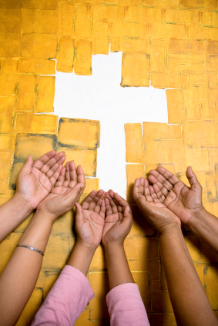
ECUMENICAL RELATIONS
Promoting Ecumenism

Slide 51
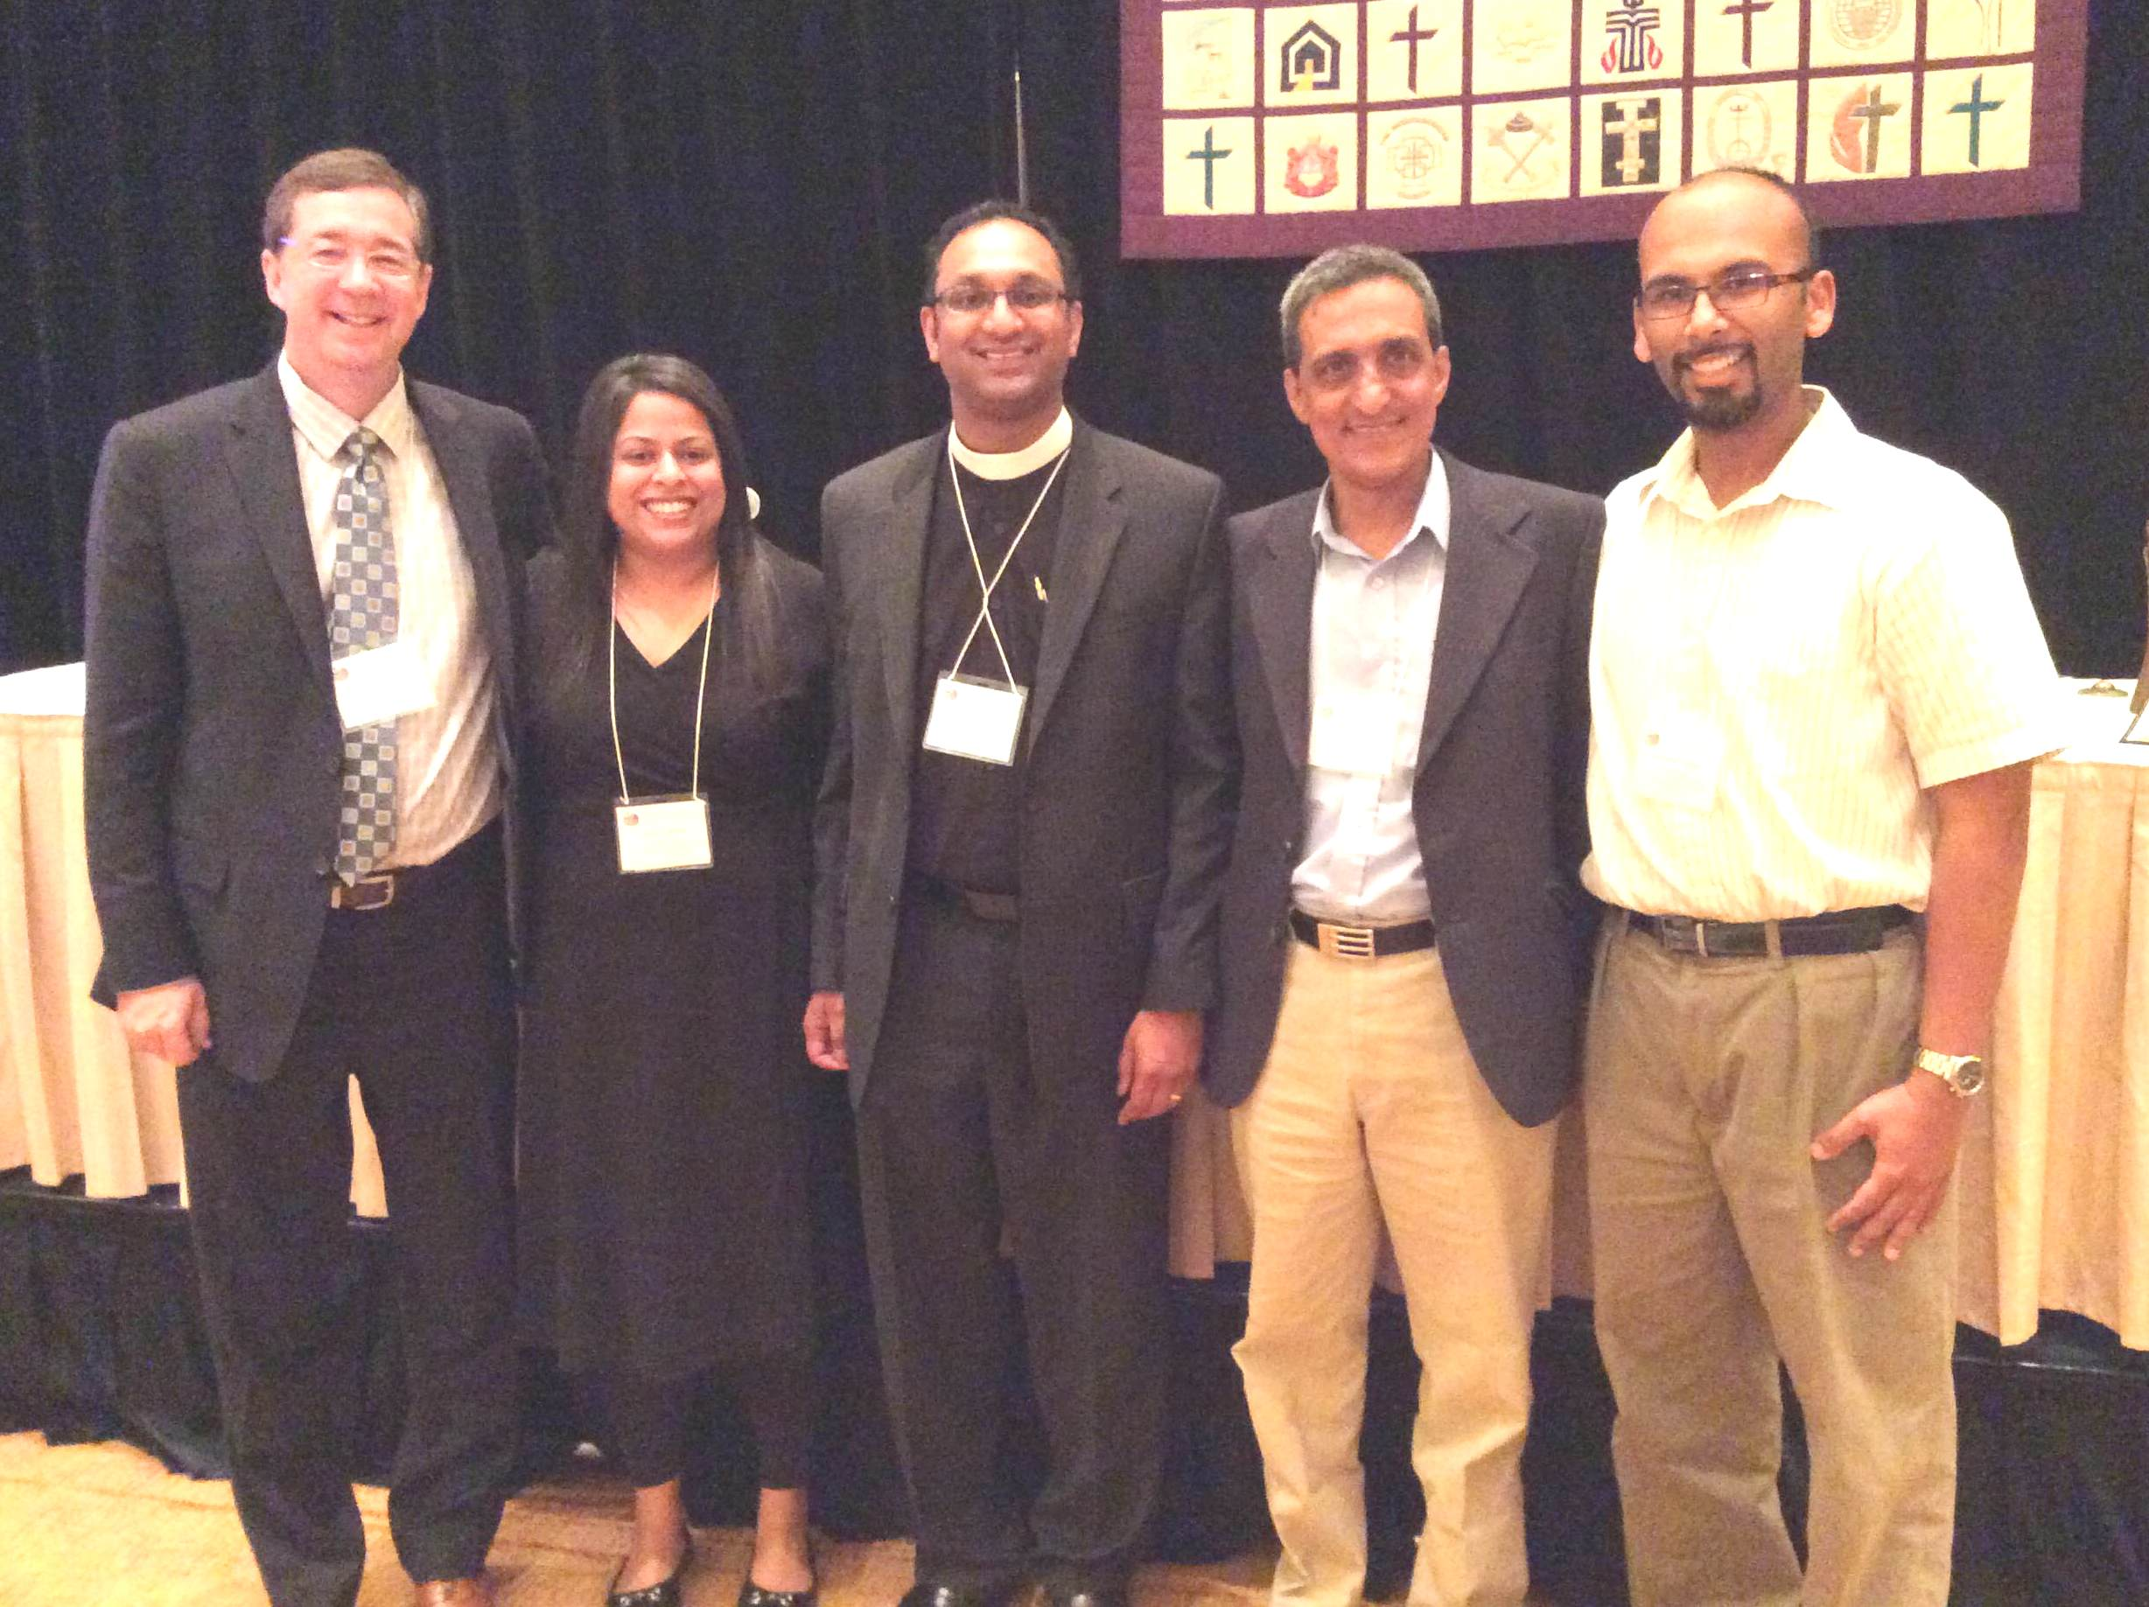
The Mar Thoma Church
Representatives at the 2014 NCC Meeting

Slide 52
IT Fellowship
Leverage technology to further the ministry of our diocese

Slide 53
IT Fellowship
-Establish a database of IT members across the diocese
-Assist the Diocese with digital communications
-Implement the current video conferencing infrastructure in our Diocese
-Create video clips for Diocesan activities
-Provide online content management for LEAD classes, Sunday School, and other online communications
Rev. Binoy J. Thomas, Diocesan Secretary
Mr. Jorge Wilson, Convener
Members:
Mr. Reji Joseph
Dr. Eugene Sadhu
Mr. Benny Philip
Mr. Anil Thomas

Slide 54
OUR CHURCH WEBSITES
Diocese of North America &
Europe of Mar Thoma Church
www.marthomanae.org
Malankara Mar Thoma Syrian Church
www.marthoma.in

Slide 55
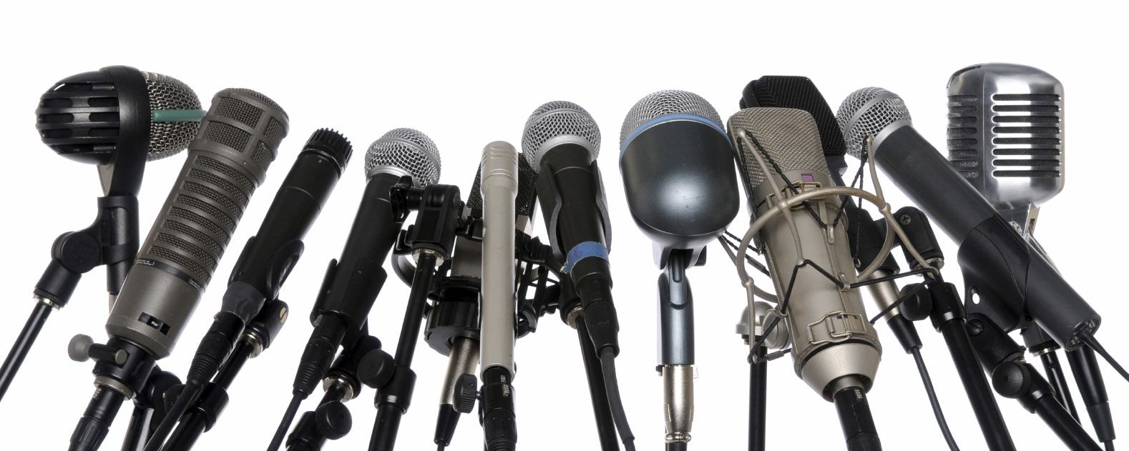
MEDIA & PUBLIC RELATIONS

Slide 56
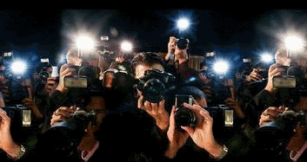
Media & Public Relations
Makes all regional and diocesan level programs known through various media outlets
Subcommittee:
Rev. Binoy J. Thomas, Diocesan Secretary
Mr. Zachariah Koshy
Mr. Anil Thomas
Mr.Alan G.John, Mr.Shaji Ramapuram

Slide 57
VAIDEEKA SELECTION
Subcommittee:
Rt. Rev. Dr. Geevarghese Mar Theodosius
Rev. Binoy J. Thomas
Rev. V.M. Mathew
Dr. M.V. Mathew
Dr. John Benjamin
Adv. John C. Thomas

Slide 58
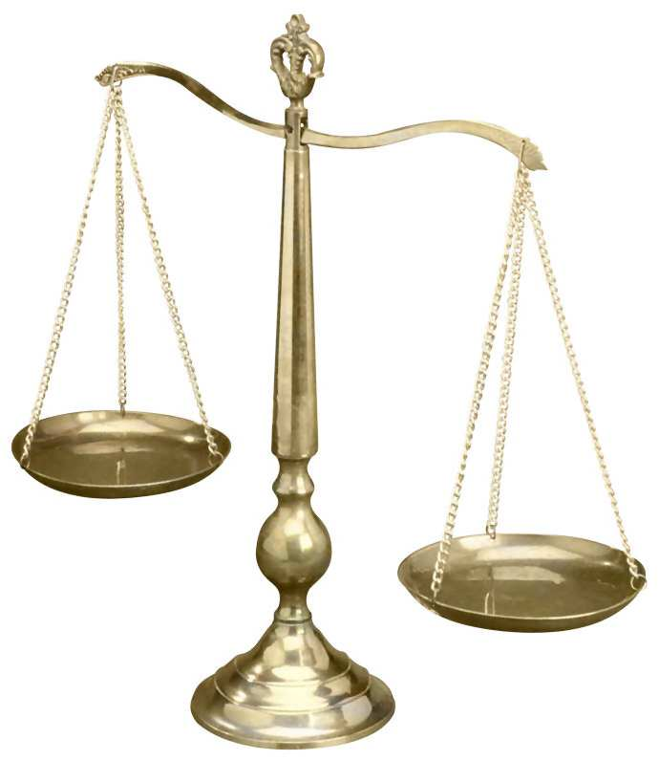
Legal Affairs
Advises the Diocesan Episcopa on all legal matters
Subcommittee:
Rt. Rev. Dr. Geevarghese Mar Theodosius
Rev. Binoy J. Thomas,
Mr. Philip Thomas
Adv. Lal Varghese
Adv. Subi Mathew
Dr. George Abraham
Mrs. Anitha Elizabeth Suhith
Dr. Joe Mathew George

Slide 59
Archives Committee
Collects materials that are landmarks
in the history of the Diocese
Subcommittee
Mr. Zachariah Mathew, Convener
Members:
Mr. Aby George

Slide 60
MAR THOMA MERIT
AWARD
To honor Mar Thoma students awarded as Valedictorians
Subcommittee
Mr. Samuel K. Samuel, Convener
Members:
Mrs. Mariamma Abraham

Slide 61
Greater things are yet to come…
Greater things are still to be done…
“For I know the plans I have for you," declares the LORD, "plans to prosper you and not to harm you, plans to give you hope and a future.” Jeremiah 29:11

Slide 62
धन्यवाद

Slide 63
Resources for Info about Diocese Activities
Achens, Diocesan Council Members, and Diocesan Assembly Members
Diocese of North America & Europe Website (www.marthomanae.org)
Page for the Diocese
(www.facebook.com/marthomanae)

