Slide 1
MAR THOMA MESSENGER
THE OFFICIAL PUBLICATION OF
THE DIOCESE OF NORTH AMERICA & EUROPE
CELEBRATING 32 YEARS of PUBLICATION

Slide 2
A Mar Thoma Magazine for All Minds
Contents
Improve your Biblical Knowledge!!
Be in the know what is happening in Mar Thoma Church, the Diocese, and in all its parishes!!
World Christian News and Reports / Awareness
Chance for you to Write / Contribute Articles/Reports
Improve your Biblical Knowledge!!
Be in the know what is happening in Mar Thoma Church, the Diocese, and in all parishes!!
World Christian News Awareness
Chance for you to Write

Slide 3
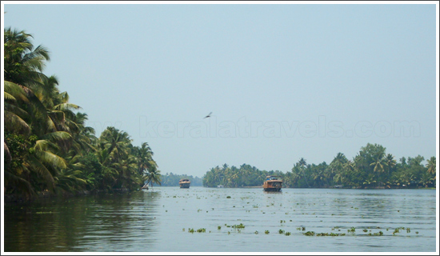
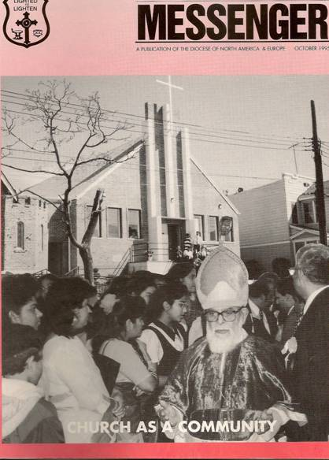
Messenger Through the YEARS
Messenger Through the YEARS

Slide 4
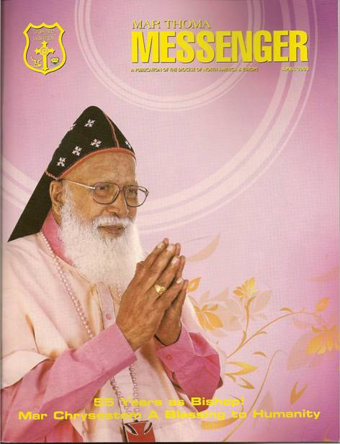
Thorough Leadership

Slide 5
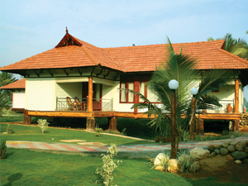
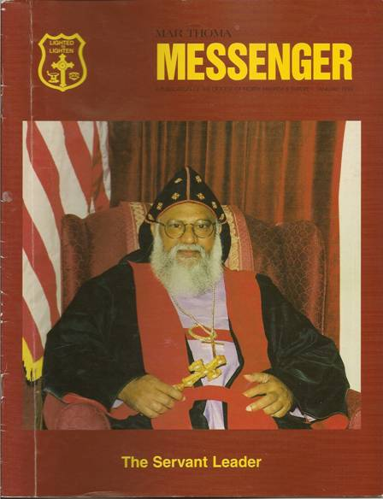
Strong Leadership

Slide 6
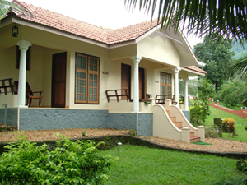
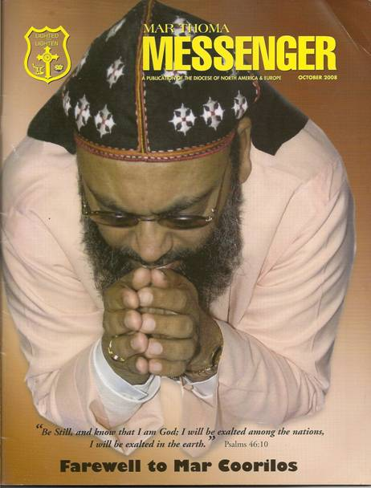
Prayerful Leadership

Slide 7
Vision of a New DIOCESAN CENTER IN NY

Slide 8
Dream Comes True Through Power of PRAYER

Slide 9
First KASSESSA from US

Slide 10
Messenger and YOU
Encourages Spiritual Living
Promotes Biblical Knowledge
Educate the Scholars
Reminds the Mottos of Mar Thoma Church
Relate to Roots and Origins of Malankara
Instill Family Values
Rejuvenates Faith
Mind Sanctification

Slide 11
Mission Without Borders

Slide 12
Mexico Mission

Slide 13
Mexico Mission Second Phase

Slide 14
Native American Mission (USA)

Slide 15
Maramon Convention

Slide 16
Memories!!

Slide 17
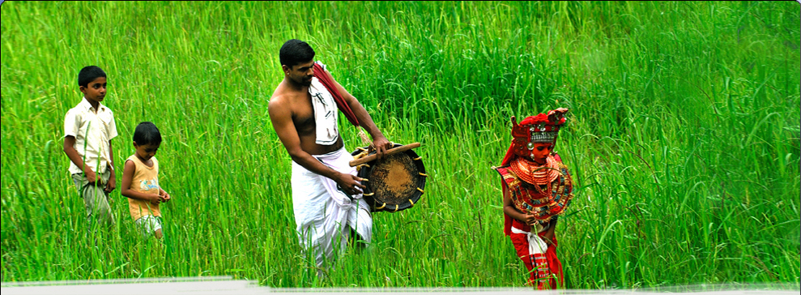
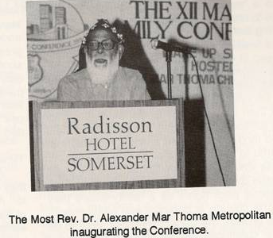
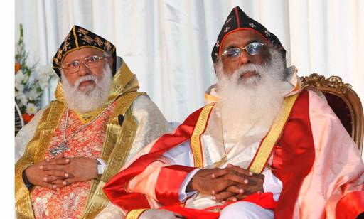
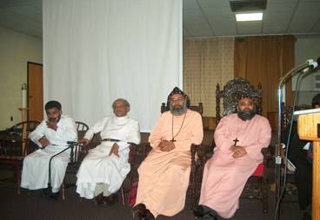
Photos
Youth Conference 2005

Slide 18
Memorable Photos from Messenger
Youth Conference 2005

Slide 19
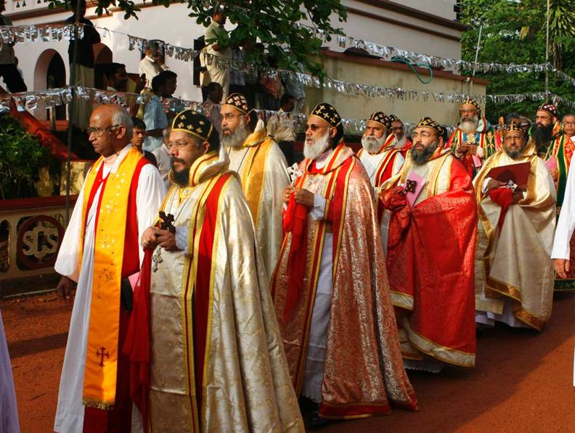

Slide 20
Few Memorable Special Editions
Sunday School & Youth
Mission Projects
Sevika Sanghom
Voluntary Evangelists Association
Leadership
Navathy Project
Mar Thoma Diaspora
Mexico Mission
Spirituality
21st Century Challenges
Mar Thoma Church Through History

Slide 21
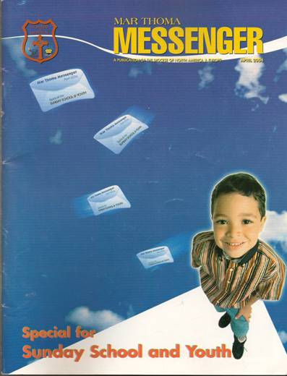
Sunday School & Youth
Sunday School & Youth

Slide 22
Metropolitan’s Visit

Slide 23
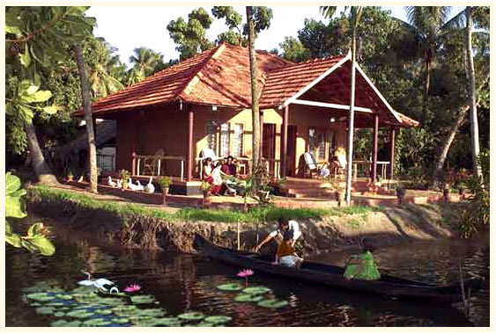
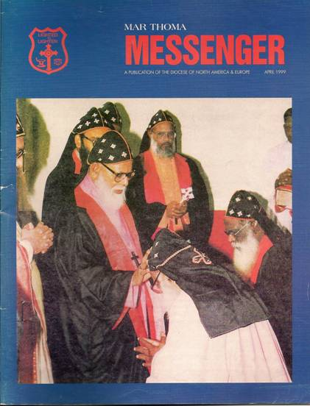
Mar Thoma CHURCH TURNING POINTS

Slide 24
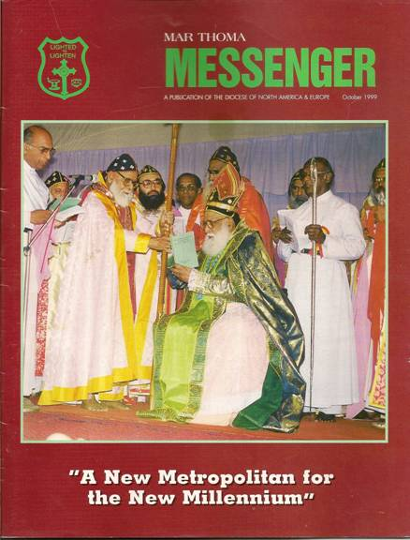
Historical Days!!
Historical Days!!

Slide 25
Our Current Shepherd

Slide 26
Celebrating 25 Years as a Diocese

Slide 27
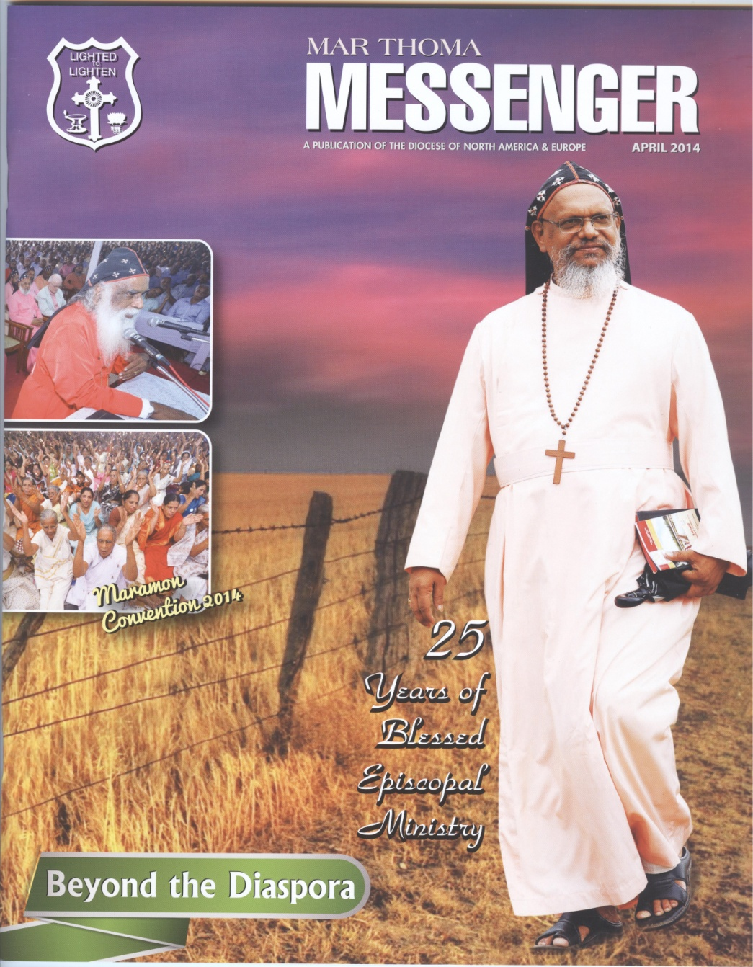
Beyond the Diaspora

Slide 28
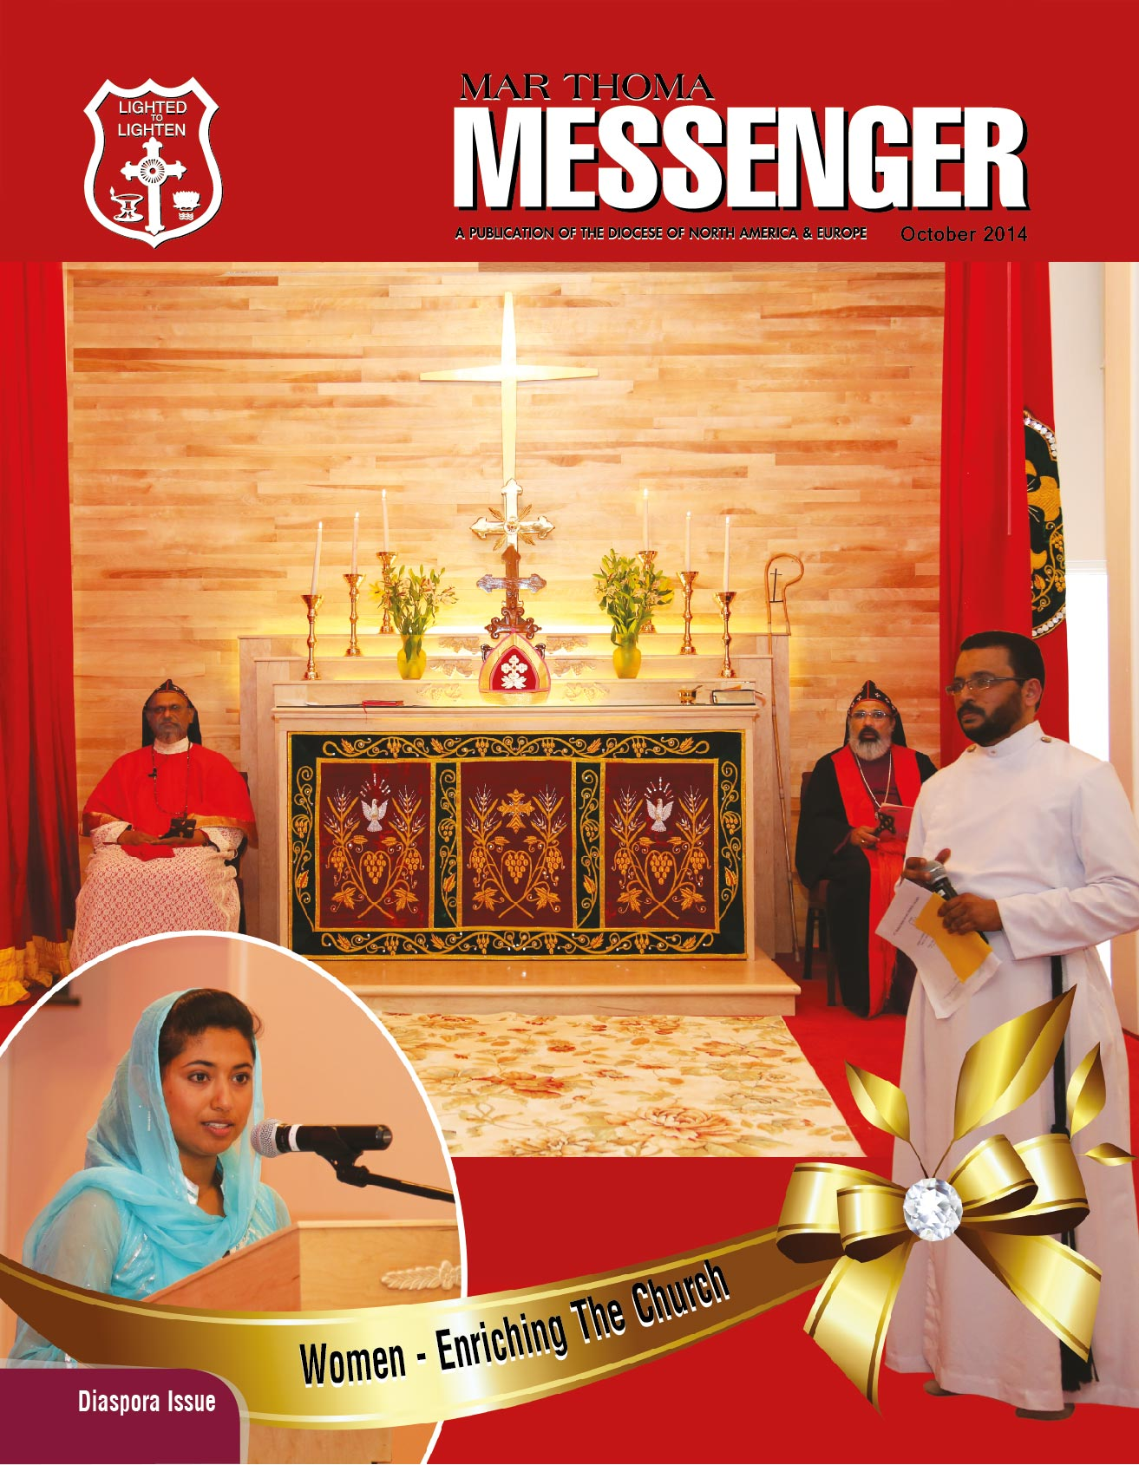
Current Issue

Slide 29
JOIN MESSENGER AS:
A valued subscriber
A Writer
A local promoter
A Graphics and Design Specialist
A Critical Reader
An Advertisement Subscriber
A Malayalam Composer
And a Supporter With Sincere Prayers!!!!

Slide 30
EDITORIAL BOARD
Patron: Rt. Rev. Dr. Geevarghese Mar Theodosius Episcopa
Editorial Board / Committee
Rev. Binoy J. Thomas (Diocesan Secretary)
Dr. Mathew T. Thomas (Chief Editor)
Editorial Board:
Rev. Binoy J. Thomas, Dr. Mathew T. Thomas,
Mr. Santhosh Abraham, Mr. George Sam,
Dr. Nancy George Maliacal, Ms. Laila Alex,
Ms. Mary Varghese
Managing Committee:
Rev. Binoy J. Thomas, Mr. Philip Thomas,
Mr. Samuel K. Samuel, Mr. Jaffey Chacko,
Mr. Zachariah Mathew, Mr. T.A. Mathew,
Mr. Georgey Mathews

Slide 31
SUBSCRIPTION RATES
Two Years-$25 (Canada $25, UK £12)
Five Years-$60 (Canada $60, UK £30)
Life Membership - $300/UK £180

Slide 32
ADVERTISE IN MESSENGER
Back Cover/Color - $2,000/Year
Front Inside/Color - $1,500/Year
Back Inside/Color - $1,500/Year
Inside Full/B&W - $700/Year
Inside Full/B&W - $200/Issue

Slide 33
PLEASE SUBSCRIBE TO MESSENGER
25th Year of Episcopal Consecration

Slide 34
Thanks To Achens, Diocesan Council / Assembly Members, Parish, & Area Promoters for their Valuable Support
धन्यवाद
Become a Subscriber to Mar Thoma Messenger and Support the Missions of this Diocese in its Continued Growth

